Slide 1
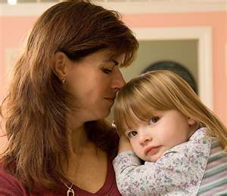
Children’s Mental Health
Emotional
Behavioral
Relational
Cognitive
Physical
Neurological
Developmental
Environmental

Slide 2
Each Child and Family is Unique
You know your child best
You are critical in the process

Slide 3
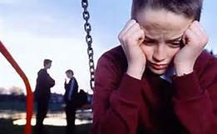
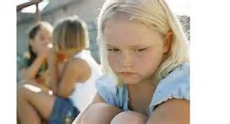
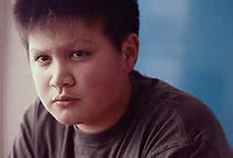
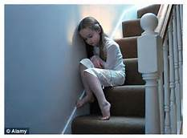
What to watch for:

Slide 4
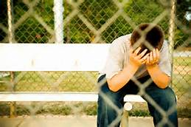
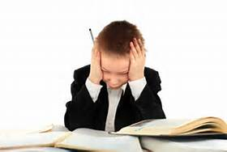
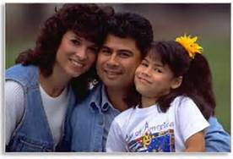
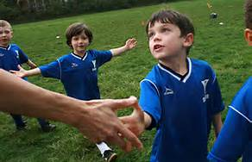
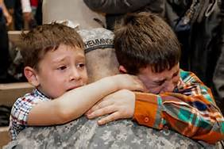
CHANGES:

Slide 5
Many everyday stresses can cause changes in your child's behavior.
Sibling birth
Illness
Death of loved one
Losses
Moves and other changes
Traumatic Event
Even good changes
It is important to be able to tell the difference between typical behavior changes and those associated with more serious problems.

Slide 6
Pay special attention to behaviors that include:
Problems across a variety of settings - school, home, peers
Changes in appetite/sleep
Social withdrawal or fearful behavior toward things your child normally is not afraid of
Returning to behaviors more common in younger children, such as bed-wetting, for a long time
Signs of being upset, such as sadness or tearfulness
Signs of self-destructive behavior, such as head-banging, or a tendency to get hurt often
Repeated thoughts of death

Slide 7
In older children and pre-teens
Changes in school performance, falling grades
Change in friends/interests
Inability to cope with daily problems and activities
Changes in sleeping and/or eating habits
Excessive complaints of physical problems
Defying authority, skipping school, stealing, or damaging property
Intense fear of gaining weight
Sadness loss of interest
Long-lasting negative mood, often along with poor appetite and thoughts of death
Frequent outbursts of anger/irritability
Abuse of drugs and/or alcohol

Slide 8
In younger children
Changes in school performance
Poor grades despite strong efforts
Excessive worry or anxiety
Hyperactivity
Persistent nightmares
Persistent disobedience and/or aggressive behavior
Frequent outbursts of anger/frustration

Slide 9
Symptoms can be caused by events such as: death in the family illness in a parent family financial problems divorce
Every member of a family is affected by tragedy or extreme stress, even the youngest child. It's normal for stress to cause a child to be upset. Remember this if you see emotional or behavioral symptoms in your child.

Slide 10
Talk to doctor, school social worker or other mental health professional:
If it takes more than one month for your child to get used to a situation, or if your child has severe reactions.
or
If your child’s response to stress is not getting better with time.

Slide 11
Who might help?
Mental Health Professionals – Clinical Services
Psychologist – PhD or PsyD, psychological evaluation (testing), diagnostic assessment and therapy
Master’s level therapist – LMFT, LPCC, LICSW – therapy, diagnostic assessment
Psychiatrist – MD, medication management
Mental Health Practioner – works under DA and treatment plan, supervision of MHP, skills
Children’s Mental Health Case Manager-
A Social service to coordinate resources
Does not provide treatment/therapy
Need current Diagnostic Assessment to qualify

Slide 12
What to expect?

Slide 13
Diagnostic Assessment
First Step in Mental Health Process
Required to access all Mental Health Services
Required for medical necessity and reimbursement
Symptoms, history, records review, observation
Lots of questions and parent participation
Parent is the expert on child
Check qualifications and experience

Slide 14
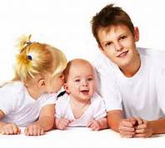
Therapy
Individual
Group
Family
In-home Family
45 minutes- 1.5 hours
Weekly for 3 months –year+
Starts with diagnostic assessment
Much parent involvement in DA, Treatment planning and home work.
Check credentials and experience

Slide 15
Psychologist
Therapy
Psychological Evaluation- Testing
Specific referral question
2 hours to 8 hours+ depending on question
Often referred by other provider to clarify diagnosis or qualify for service
Often includes Diagnostic Assessment
Check credentials and experience

Slide 16
Psychiatrist
Medication Management
Short appointments 10-30 minutes
Spacing one week to 6 months
No therapy
Often referral fro therapy or testing
Check credentials and experience

Slide 17
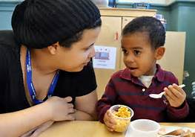
SKILLS
Mental Health Practitioner under direction of MHP
DA must recommend as medically necessary to treat MH symptoms
Teaching behavioral and emotional skills related to diagnosis

Slide 18
Scott County Mental Health Center
Community Based
Outpatient Services
Rule 29 Licensed
Insurance/MN Sure/MA
Sliding Fee

Slide 19
Staff
Child, Adolescent and Adult Psychiatrists
Doctoral Level Psychologists
Master’s Level Therapists
Psychiatric Nurse
Mental Health Practitioners
Intake Team- scheduling, triage, eligibility and insurance

Slide 20
Services
Crisis Assessment and Intervention
Diagnostic Assessments
Psychiatry/Medication Management
Psychological Evaluations- forensic, ADHD, diagnostic, personality, cognitive, developmental, ASD etc.
Family Assessments/Parenting Assessments/Parent Child Interaction Assessments
Therapy- individual, family , group, couples
In-home family therapy
Training and Consultation

Slide 21
Groups and Programs
Dialectical Behavior Therapy- adult, adolescent
Trauma Focused Treatment Certified
Play Therapy
School Based Therapy
In-home Family Therapy
Illness Management/Wellness
Anger Management – Alternatives to Violence
Truancy Prevention
Anger Management
Parent Education & Support– Raising Capable People

Slide 22
Service Locations/Sites
SCMHC
Home
New Beginnings
Jail
Juvenile Alternative Facility - JAF
Employment & Training
Schools
Head Start

Slide 23
Carver County’s FIRST STREET CENTER in Waconia 952-442-4437
Mental Health Counseling-Onsite
Mental Health Crisis Program-Scott/Carver
School-Linked Mental Health Services:Waconia, Watertown, Eastern Carver Cty and now NYA.

Slide 24
CARVER COUNTY’S MENTAL HEALTH SERVICES FOR CHILDREN
Counseling at FIRST STREET CENTER in Waconia
Carver/Scott Mental Health Crisis Program: 24-hrs/day/7-days/week telephone crisis response/triage for all ages for anyone regardless of their ability to pay. Provided in any community location that is safe/appropriate by Mental Health Professionals/Practitioners
School-linked Mental Health Services: Day Treatment, Counseling in Carver county Middle/ High schools, Individualized Education Plan social-emotional skills work.

